Slide 1
Background / Deployment:
PyPI - the package index
Wilber Hernandez
wilberhdez@gmail.com
https://www.linkedin.com/in/wilberhdez26/

Slide 2
Content
Intro
Python Package
Package Management Systems -vs- Package Managers
Facts About PyPI
Contents of a Distribution Package
Benefits of Packaging
Python Build Workflow
The Python Build System
Distribution Package Artifacts Created
Metadata between project and distribution package
A Continuous Integration Pipeline
Deployment / Publishing Your Package
PIP Package Manager
Resources

Slide 3
Python Package
What is a package?
Software and metadata rolled together
Two concepts defined by the Python Packaging Authority
import packages
distribution packages
archiving Python projects for publishing for others to use
Notes:
Python packaging has a messy history, and many alternative options.
Packaging is the act of archiving software with metadata to describe those files, with the purpose of sharing or publishing them.
Let's start with, what is a package?
The Python ecosystem uses the word “package” for two different concepts.
These 2 concepts can be found in the “Python Packaging User Guide” from the Python Packaging Authority (https://packaging.python.org).
The concepts are,
1 - “import packages” - is about organizing multiple Python modules into a directory for discovery purposes, http://mng.bz/wypg
2 - “distribution packages” - is about archiving Python projects for publishing for others to use, http://mng.bz/qoNz
Here, we’ll concentrate on the second one.

Slide 4
Package Management Systems -vs-
Package Managers
Package Management System
PyPI (Python Package Index)
Python’s community official repository for installing packages
to manage (standardize) the experience of installing and using others’ code
Conda-forge
Package Managers
pip
conda
Developers publish packages to software repos for others to use
Package managers install packages from software repositories to consumer’s system
Software repository
Package
Package Manager
Notes:
PyPl, is Python’s community official (or de facto) standard repository for installing Python packages (https://pypi.org).
Also, it is a “Package Management System” to help in setting a standard for the rollout of these software packages and its metadata.
Is used by maintainers and users of that software to manage the experience and reduce the manual work of installing and using the code.
The same can be said about Conda-forge, which is the package index that is coupled with Anaconda.
Much like Docker Hub is for Docker images (https://hub.docker.com/).
On the other hand, “Package Managers” provide tools to help in the installation of dependencies for some project, programming language, framework, or OS level. We’ll cover this towards the end.
You may have used these,
pip (https://pip.pypa.io)
conda (https://docs.conda.io)
Homebrew (https://brew.sh/)
npm (https://www.npmjs.com/)
Fyi -
Creating environments ⇒ venv, virtualenv, pipenv, poetry, pyenv, and anaconda
Package installation ⇒ pip, poetry, pipenv, and conda
Managing dependencies ⇒ requirements.txt, poetry, and pipenv

Slide 5
Facts about PyPI
Pronounced "pie pea eye" (aka, the “Cheese Shop”)
PyPI came about around a decade after Python was released in Feb 1991
Contribute to PyPI
Lots of work at the Warehouse project
Donations are appreciated
Changes announced on
pypi-announce mailing list
PSF blog (under label “pypi”)
Notes:
Pronounced "pie pea eye" (aka, the “Cheese Shop”)
This helps to minimize confusion with the PyPy project (a Python interpreter and JIT compiler)
The Python Package Index (PyPI) became available ALMOST a decade after Python was release in February 1991 when Guido van Rossum published the first release of Python on Usenet.
Around the beginning of 2001.
These are the different ways to contribute to PyPI. Look into joining the Warehouse project, or through donations.
Also, changes are announced via the mailing list, and PSF blog.
Fyi -
Contributing to PyPI?
https://pypi.org/help/#contributing
Changes to PyPI are generally announced on both the pypi-announce mailing list and the PSF blog under the label "pypi". The PSF blog also has Atom and RSS feeds for the "pypi" label.
https://pypi.org/help/#upcoming-changes
Wikipedia
https://en.wikipedia.org/wiki/Python_Package_Index
PyPI primarily hosts Python packages in the form of archives called sdists (source distributions) or precompiled "wheels."

Slide 6
Contents of a Distribution Package
Distribution packages for distributing code and other kinds of files
Source code
File 1
File 2
File 3
README
Distribution
package
Makefile
Configuration and compilation code with instructions to help the user build and use your software
Metadata
Metadata about the package (name, version - to help set it apart from other packages or versions)
Notes:
By distributing a package, your users will have a one-stop shop to have everything they need to get started in using your software.
This is a high-level view of what a “Distribution Package” is made of.
Some of that metadata information includes,
the name of a software project
its creator(s)
the license under which it can be reused
and the version of the package that you are releasing
Now, in the early days before PyPI, sharing software was a very manual process like,
downloading source code
compiling it
and any additional headache with the artifacts of that compilation were all left up to the person trying to use the code
Each of those steps introduced a point-of-failure because of human error and architectural or environmental differences between systems.
However, tools like Make (https://www.gnu.org/software/make/) removed some of this variation from the process but stopped shy of package version, dependency, and installation management.

Slide 7
Benefits of Packaging
Sharing software with people
Stronger cohesion and encapsulation
Clearer definition of ownership
Looser coupling between areas of the code
More opportunity for composition
Notes:
Here are some benefits of packaging.
Besides the goal of sharing software, you’ll also get stronger cohesion - which is about how a block of code sticks to doing one job well.
(Fyi - The more stray functionality is floating around, the less cohesive the code is.)
Creating cohesion and packaging a cohesive area of code is a gateway into encapsulation.
Encapsulation helps you build the right expectations with your users about how to interact with your code by defining how your code’s behavior is exposed, and by better defining the API contract that’s less subject to change.
Any team working to create this package will benefit from clear ownership over areas of code.
By keeping the scope of a bounded area of code small your team can have clear ownership of their code.
Packaging is one tool for managing scope.
Another benefit is that it promotes loose coupling by reducing interdependence between areas of code.
Code becomes flexible so you can implement and choose from a variety of execution strategies instead of being forced down a particular path when writing your code.
Python packaging can even decouple usage in Python from the language in which a package is written in C and even Fortran for improved performance or integration with legacy systems.
You can do this by providing precompiled versions of these packages alongside versions that can be built from source if needed.
(Fyi - This also makes packages more portable, decoupling developers somewhat from the details of the computer or server they’re using.)
Finally, you can see great examples of composition at play in packaging through Python frameworks like Django (https://www.djangoproject.com).
Django is itself a package, and because it’s built as a plugin-based architecture, you can extend its functionality by installing and configuring additional packages.
There are hundreds of packages listed on the website, Django Packages (https://djangopackages.org).
(Fyi - There you’ll see the kind of wide adoption the packaging approach enjoys.)

Slide 8
Python Build Workflow
Setup a virtual environment, and install dependencies using pip
Types of build systems
Frontend tool
Python package build system ⇒ $ pyproject-build
pip
Backend tools
Traditional:
Setuptools
Modern:
Hatch, Poetry, Flit, Maturin (Rust), Sphinx doc themes
Notes:
We already covered this during the previous meeting.
But to quickly give you a high-level description of a Python build workflow. First,
setup a virtual environment (I used virtualenv)
create the necessary metadata files and your code
in the root directory for your project, start by using a “Build Frontend tool” to build your package-artifacts using the following command:
$ pyproject-build
If anything is missing or misconfigured, the output makes two file suggestions.
A build frontend is a tool you run to initiate building a package from source code.
The build frontend provides a user interface and integrates with the build backend via the hook interface.
So you use a build frontend tool like build to trigger a build backend like Setuptools to create package artifacts from your source code and metadata.
A build backend is a Python object that provides several required and optional hooks that implement packaging behavior.
The core build backend interface is defined in PEP 517 (http://mng.bz/o5Rj).
A build backend does the logistical work of creating package artifacts during the build process, namely through the build_sdist and build_wheel hooks.
The build tool uses Setuptools as a build backend by default when you don’t specify one.
Setuptools uses the wheel package to build the wheel during the build_wheel step.
These are other build-backend tools that you can use - Hatch, Poetry, flit, Maturin, and Sphinx.
Todo (share links):
https://test.pypi.org/project/pubpypack-gadget-wilber-hdez
https://github.com/wilberh/pubpypack-gadget-wilber-hdez
## INSTALLATION
pip install -i https://test.pypi.org/simple/ pubpypack-gadget-wilber-hdez
## IMPLEMENTATION
```shell
>>> from imppkg import hello
>>> hello.first_word
'hello'
>>>
—----------------------------------------------------
—----------------------------------------------------
Fyi -
DO ONE THING, AND DO IT WELL
You have to wonder why the Python community decided to split up responsibilities between several packaging tools.
We know most programming languages other than Python come with a single tool for building and packaging.
Well, the answer has to do with the history of the Python project.
Python is a decentralized open-source project driven by a community of thousands of volunteers, with a history that spans more than 30 years.
This makes it hard for a single packaging tool to become firmly established.
Python’s ecosystem ​and interoperability standards promote this diversity of build tools.
As a Python developer, you have a choice of small single-purpose tools that play well together.
This approach ties in with the UNIX philosophy of “Do one thing, and do it well.”
However, there are also tools like Poetry that provide a more integrated workflow.
—----------------------------------------------------
—----------------------------------------------------
(venv) $ pip install build
(venv) $ pyproject-build
Command 'pyproject-build' not found, but can be installed with:
sudo apt install python3-build
pyproject.toml is the newer standard file for configuring Python packaging introduced in PEP 518 (https://www.python.org/dev/peps/pep-0518/) and should be preferred unless a third-party tool you want to use is only compatible with setup.py.
The file uses TOML (https://toml.io/en/), an INI-like language, to split configuration into relevant sections.
Fyi - If your existing package uses the setup.py file, you should consider migrating to the pyproject.toml file and the setup.cfg
What’s happening here?
At a high level, the build command consumes your source code and the metadata you supply, along with some files it generates, to create the following:
A source distribution package—A Python source distribution, or sdist, is a compressed archive file of the source code with a .tgz extension.
A binary distribution package—A Python built distribution package is a binary file. The current standard for built distributions is what’s known as a wheel or bdist_wheel, a file with a .whl extension.
A source distribution allows almost anyone to build your code on their platform, a binary distribution is prebuilt for a given platform and saves users the work of building it themselves.
The result of building an empty Python package:
❶ Setuptool and the wheel package are used for the build backend.
❷ The source distribution package is built by the build_sdist hook.
❸ The build process expects a README file in one of a few formats.
❹ The build process expects a name and a URL for the package.
❺ The build process expects an author or maintainer of the package.
❻ The package is called UNKNOWN because no name was specified.
❼ The source distribution is a compressed archive file.
❽ The binary wheel distribution package is built by the build_wheel hook.
❾ The binary wheel distribution is a .whl file.
Because you haven’t supplied any metadata yet, the build process alerts you to the fact that it’s missing some important information like a README file, the author, and so on.
Notice that the build process installs the setuptools and wheel packages.
Setuptools (https://setuptools.readthedocs.io) is a library that was, for a long time, one of the only ways to create Python packages.
Now, Setuptools is one of a variety of available build backends for Python package builds.
Fyi - A build backend is a Python object that provides several required and optional hooks that implement packaging behavior. The core build backend interface is defined in PEP 517 (http://mng.bz/o5Rj).
A build backend does the logistical work of creating package artifacts during the build process, namely through the build_sdist and build_wheel hooks. Setuptools uses the wheel package to build the wheel during the build_wheel step. The build tool uses Setuptools as a build backend by default when you don’t specify one.
The presence of build backends may leave you wondering if there may be build frontends as well. As it turns out, you’ve been using a build frontend already. The build tool is a build frontend!
Fyi - A build frontend is a tool you run to initiate building a package from source code. The build frontend provides a user interface and integrates with the build backend via the hook interface.
To recap, you use a build frontend tool like build to trigger a build backend like Setuptools to create package artifacts from your source code and metadata.
Because the build process creates package artifacts, you can now check the effect of running the build. List the contents of the root directory for your project now. You should see the following:
$ ls -a1 $HOME/code/first-python-package/
.
..
.venv/
UNKNOWN.egg-info/
build/
dist/
pyproject.toml
The UKNOWN.egg-info/ and build/ directories are intermediate artifacts. List the contents of the dist/ directory, where you should see the source and binary wheel package files, as shown here:
$ ls -a1 $HOME/code/first-python-package/dist/
UNKNOWN-0.0.0-py3-none-any.whl
UNKNOWN-0.0.0.tar.gz
Recall that build used Setuptools as the fallback build backend because you didn’t specify one.
You can specify Setuptools as the build backend for your package by adding the lines below to pyproject.toml.
[build-system] ❶
requires = ["setuptools", "wheel"] ❷
build-backend = "setuptools.build_meta" ❸
❶ Opens a new TOML section
❷ List of package names as strings
❸ Dotted path to the object as a string
These lines specify the following:
build-system—This section describes the package build system.
requires—These are a list of dependencies, as strings, which must be installed for the build system to work. A Setuptools build system needs Setuptools and wheel, as you saw earlier in this chapter.
build-backend—This identifies the entry point to the build backend object, using the dotted path as a string. The Setuptools build backend object is available at setuptools.build_meta.
Once you’ve added the build system information, run the build again. Nothing should change in the output: you’ve just locked in Setuptools as the explicit backend instead of letting build fall back to it as a default. Now that you’ve got a handle on the Python package build system, you need to add some metadata about your package.
Required core metadata
To fix the names of your package files, start by creating the setup.cfg file in the root directory of your project.
NOTE - PEP 621 (https://www.python.org/dev/peps/pep-0621/) describes a standard for declaring static metadata in the pyproject.toml file. Although it’s been accepted, the standard is not yet widely adopted. In particular, as of the time of writing, Setuptools does not yet support it (https://github.com/pypa/setuptools/issues/1688), though some alternatives may. This and future chapters will attempt to balance the developer experience for packaging, testing, code quality, and so on across setup.py, setup.cfg, and pyproject.toml accordingly.
Two fields are minimally required for a package: name and version. These distinguish a distributed version of your package from other packages and other versions of your own package. Add the fields to setup.cfg in a section called metadata. It should look like the following:
[metadata] ❶
name = first-python-package ❷
version = 0.0.1
❶ This is the "metadata" section.
❷ Sections contain one or more key-value pairs.
After you save the file, remove the dist/ directory and run the build process again. List the contents of the newly generated dist/ directory, where you should see the following:
$ ls -a1 dist/
.
..
first-python-package-0.0.1.tar.gz
first_python_package-0.0.1-py3-none-any.whl
This confirms that you’ve supplied the name and version correctly.
The build process recognized the values you supplied and used them to populate the filenames of the package artifacts. “UNKNOWN” has been replaced by a normalized version of “first-python-package,” and “0.0.0” has been replaced by “0.0.1”
To confirm that the package contains the intended files, you can manually inspect its contents. Change to the dist/ directory and unpack the source distribution package using the following commands:
$ cd $HOME/code/first-python-package/dist/
$ tar -xzf first-python-package-0.0.1.tar.gz
This creates a first-python-package-0.0.1/ directory next to the package file, containing the files packaged from your project along with a few generated files. You should see the following:
$ ls -1R first-python-package-0.0.1/
PKG-INFO ❶
first_python_package.egg-info
pyproject.toml ❷
setup.cfg
first-python-package-0.0.1/first_python_package.egg-info:
PKG-INFO
SOURCES.txt
dependency_links.txt
top_level.txt
❶ The source distribution contains several generated files.
❷ The source distribution also contains files you created in your project.
You can also confirm that the metadata you specified has been faithfully reproduced in the package. Open either of the PKG-INFO files and take a look at the contents. The PKG-INFO file contains a normalized version of the metadata. You should see the following:
Metadata-Version: 2.1
Name: first-python-package ❶
Version: 0.0.1 ❷
Summary: UNKNOWN ❸
Home-page: UNKNOWN
License: UNKNOWN
Platform: UNKNOWN
UNKNOWN
❶ The package name you specified maps to the Name field.
❷ The package version you specified maps to the Version field.
❸ Fields you haven’t specified yet show as UNKNOWN.
The package name and version you specified show up here, but there are several other fields that are still UNKNOWN. The build process is still alerting you to a missing URL, README, and author information as well. Next, you’ll fix these issues and flesh out the metadata a bit further to tell people about the package.
—--------------------------
Optional core metadata
The name and version are the only two strictly required fields, per the core metadata specification (http://mng.bz/nez8), but several other fields are indexed by search engines or surfaced in highly visible ways on sites like PyPI. If you want others to find and use your package, it’s a good idea to supply information for as many of the fields as possible.
A rundown on package metadata
If you want to learn all the different fields available and how they’ve evolved over time, the following PEPs (https://www.python.org/dev/peps/) deal with the package metadata specification:
PEP 241: Metadata for Python Software Packages (https://www.python.org/dev/peps/pep-0241/) introduces the PKG-INFO file.
PEP 301: Package Index and Metadata for Distutils (https://www.python.org/dev/peps/pep-0301/) introduces the idea of a centralized Python package index as well as classifiers to better distinguish Python packages.
PEP 314: Metadata for Python Software Packages v1.1 (https://www.python.org/dev/peps/pep-0314/) augments PEP 241 with additional fields.
PEP 345: Metadata for Python Software Packages 1.2 (https://www.python.org/dev/peps/pep-0345/) augments PEP 314 with additional fields, changed fields, and deprecated fields.
PEP 566: Metadata for Python Software Packages 2.1 (https://www.python.org/dev/peps/pep-0566/) augments PEP 345 with the core metadata specification, stricter allowable values for package names, additional fields, and a canonical transform of package metadata to JSON.
PEP 621: Storing project metadata in pyproject.toml (https://www.python.org/dev/peps/pep-0621/) defines a standard for providing package metadata in the pyproject.toml file as opposed to files like setup.py or setup.cfg. This has been accepted but doesn’t yet have wide adoption by packaging tools.
PEP 639: Metadata for Python Software Packages 2.2 (https://www.python.org/dev/peps/pep-0639/) proposes an approach to standardizing how licenses are specified for packages.
The core metadata specification provides the most current list of available fields and their format.
The build process is still alerting you to a missing URL and author information. Add the following fields to the [metadata] section in the setup.cfg file, filling in your personal information where appropriate:
...
url = https:/ /github.com/<username>/<package repo name>
author = Given Family
author_email = "Given Family" <given.family@example.com>
Run the build again, and you should no longer see the alerts about a missing URL and author. Unpack the source distribution file and view the PKG-INFO file again. You should see the following, with the new values you’ve added:
Metadata-Version: 2.1
Name: first-python-package
Version: 0.0.1
Summary: UNKNOWN
Home-page: https:/ /github.com/<username>/
➥ <package repo name> ❶
Author: Given Family ❷
Author-email: "Given Family" <given.family@example.com>
License: UNKNOWN
Platform: UNKNOWN
UNKNOWN
❶ The url field maps to Home-page.
❷ The author and author_email fields map to Author and Author-email.
The summary is still showing as UNKNOWN. The summary is a short description of the package’s purpose. You can think of this as an elevator pitch for your package: it’s what people will see most often when they’re searching for packages to use. If you’re reading this book, chances are that you want to learn how to share your code. If you skimp on the metadata, it’s likely that no one will find it. Metadata ensures that your package will be as discoverable as possible further down the line. In Setuptools, the summary is called description. Add the description field to your metadata now, like so:
...
description = This package does amazing things.
There’s also that unlabeled UNKNOWN lurking at the end of the file. That space is for the package’s long description, which can provide more details about how to install and use the package or what problems it solves. Recall that the build process is still complaining about a missing README file. You can fix both these issues in one pass by creating a README file and referencing it in the metadata. Create a README.md file now, with content something like the following:
# first-python-package
This package does amazing things.
## Installation
```shell
$ python -m pip install first-python-package
```
In setup.cfg, you can now use the long_description field to reference your README file using the special file: directive. The file: directive accepts the path to a file, relative to setup.cfg, whose contents should be taken as the value for the field. In addition, you also need to specify the long_description_content_type field to indicate that your README is something other than plain text. Because your file is a Markdown file, you should specify the text/markdown content type. Add both of these fields to your metadata now:
...
long_description = file: README.md
long_description_content_type = text/markdown
Run the build, extract the source distribution, and inspect PKG-INFO again. You should see the following:
The Summary field is populated with the short description.
The file now contains a Description-Content-Type with a value of text/markdown.
The UNKNOWN at the end of the file is now replaced with the contents of your README.md file.
When you update your README file, those changes will be pulled into the next version of the package you build. This automation reduces the issue of remembering to update your documentation in multiple places. The license is the last UNKNOWN field you’ll address for now, and it requires some special attention.
—--------------------------
Specifying a license
In most regions, software is protected by copyright by default. If you don’t provide any license, you’re not giving anyone permission to use your code—even if you publish it as open source software (see Tal Einat, “Over 10% of Python Packages on PyPI Are Distributed without Any License,” Snyk, http://mng.bz/vX9q). Licenses are important because they help your users understand the conditions under which they’re allowed to use your software. The detailed process of choosing a specific license is outside the scope of this book, but sites like Choose a License (https://choosealicense.com) guide you through the process by asking you what freedoms and restrictions you want to provide with your software.
License granularity
Most often, you need to specify the license that pertains to your entire package only once at the package metadata level. If you need to give a more permissive or restrictive license to a specific file or files, you can include the overriding license directly in those files. The Python packaging process doesn’t provide a way to handle complex per-file license granularity within a project, but third-party tools may exist to help with this.
Once you choose a license, you need to declare that license alongside your code so that users can identify whether they can work with your software. Sites like GitHub automatically discover license information from a few files like LICENSE or LICENSE.txt. At the same time, you need to provide your license in your source and binary package distributions so people who install your package can view the license as well.
To properly identify your license of choice and to include the license information in your built package distributions, use a combination of the following three fields:
license—Specifies the identifier from the SPDX license list (https://spdx.org/licenses/) that corresponds to your chosen license
license_files—Specifies the path to one or more license files, relative to setup.cfg
classifiers—Specifies any relevant trove classifiers (https://pypi.org/classifiers/) your package falls under for discovery purposes
As an example, if you were to choose the MIT License (https://mit-license.org/), you’d place a copy of the license text in a LICENSE file in the root directory of your project, and then add the following fields to your metadata:
...
license = MIT
license_files = LICENSE
classifiers =
License :: OSI Approved :: MIT License
Now you’ve learned how to specify a variety of metadata about your package for the Setuptools build backend, and you’ve seen how the build system normalizes and uses that metadata when it builds distribution packages.
—---------------------------------------
Fyi-
You can specify the required Python version or range of versions with the python _requires keyword in the [options] section of the setup.cfg file, using the same PEP 440 (https://peps.python.org/pep-0440/) version specifiers that you use to specify package versions. Add this to your setup.cfg file now. It should look like the following:
[options]
...
python_requires = >=3.9
—---------------------------------------
Fyi -
Specifying dependencies for Python packages
Setuptools looks for package dependencies in the install_requires key of the [options] section in the setup.cfg file. The install_requires value is a list of dependencies specified using the same syntax you would use in a requirements.txt file.
Add the install_requires key now. It should look like the following snippet:
[options]
...
install_requires =
termcolor>=1.1.0,<2
—---------------------------------------
Fyi -
You can use this environment to test the installation of your package. Use the pip module to install it using the following command from the root directory of your project. The . indicates that pip should install the current directory as a package:
$ py -m pip install .
After the command completes, your first-python-package package will be installed just as if it had been installed from PyPI!
—---------------------------------------
If you want to explore some alternative build tools, check out Poetry (https://python-poetry.org/), flit (https://flit.readthedocs.io), and hatch (https://hatch.pypa.io). Each build system makes different trade-offs between ease of configuration, capability, and user interface. As an example, flit and poetry are geared toward pure-Python packages, whereas Setuptools can support extensions in other languages.

Slide 9
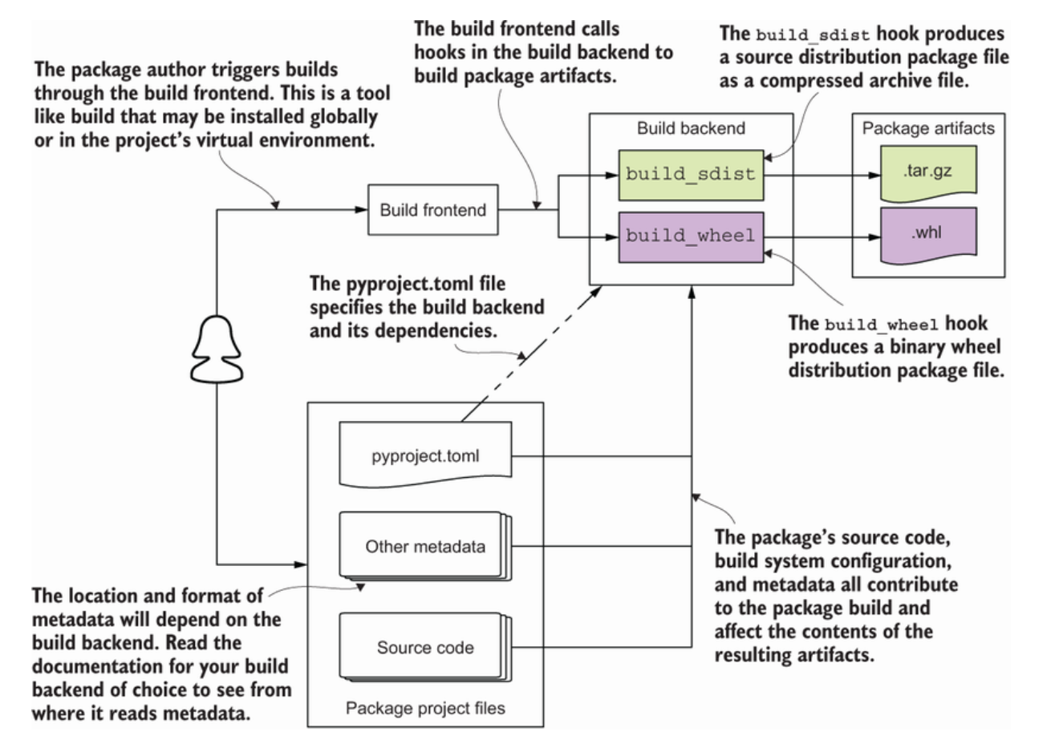
The Python Build System
Notes:
Let’s see and try to picture how all these things work together.
In case I haven’t mention it, the pyproject.toml contains your metadata.
It is the newer standard file for configuring Python packaging introduced in PEP 518 (https://www.python.org/dev/peps/pep-0518/) and should be preferred unless a third-party tool you want to use is only compatible with setup.py.
Python’s project specification file uses TOML (Tom’s Obvious Minimal Language ; https://toml.io/en/), an INI-like language, a cross-language format for configuration files that’s both unambiguous and easy to read and write. The TOML website has an excellent introduction to the format.
https://toml.io/
Please note, if you already have a package and it uses the setup.py file, you should consider migrating to the pyproject.toml file and the setup.cfg
Something to point out about the metadata -
You should start by creating a setup.cfg file in the root directory of your project. Why?
Because PEP 621 (https://www.python.org/dev/peps/pep-0621/) describes a standard for declaring static metadata in the pyproject.toml file.
The PEP has been accepted, BUT the standard is not yet widely adopted.
Currently, Setuptools backend does not yet support it (https://github.com/pypa/setuptools/issues/1688), but some alternative backends do.
Future chapters will attempt to balance the developer experience for packaging, testing, code quality, and so on across setup.py, setup.cfg, and pyproject.toml accordingly.
Wanted to let you know that 2 fields are minimally required for a package: name and version.
This is to distinguish a distributed version of your package from other packages and other versions of your own package.
Add the fields to setup.cfg in a section called metadata. It should look like the following:
[metadata] ❶
name = first-python-package ❷
version = 0.0.1
We already know the Python build system consists of a frontend user interface that integrates with a backend to build package artifacts.
Let’s talk more about the Build Frontends and Build Backends:
In the Frontend,
—Pip and build don’t know how to assemble packaging artifacts from source trees.
They delegate that work to the tool you declare in the build-system table.
In this relationship, pip and build take the role of build frontends, the tools an end-user invokes to orchestrate the build process.
The tool that does the actual building is known as the build backend.
Build backends write out core metadata fields based on what you specify in the project table of pyproject.toml
You specify which backend to use in the TOML file,
Two fields are essential and mandatory for every package: project.name and project.version
There are a number of optional fields you can provide, such as the author and license, a short text describing the project, or third-party packages used by the project
Is not on this picture, but a pyproject.toml file contains up to three tables:
1—a “build-system” table
Specifies how to build packages for the project (see “Build Frontends and Build Backends”).
2—a “project” table
Holds the project metadata (see “Project Metadata”).
3—a “tool” table
Stores configuration for each tool used by the project. For example, the Black code formatter uses tool.black for its configuration.
Now, the artifacts (Wheels and Sdists files) -
The build placed two packages/artifacts for your project in the dist directory:
random_wikipedia_article-0.1.tar.gz
random_wikipedia_article-0.1-py2.py3-none-any.whl
These artifacts are known as wheels and sdists.
Sdists are tar archives with gzip compression (.tar.gz)
Sdists, by contrast, are SOURCE-distributions: they require an additional build step to produce an installable wheel.
Wheels are ZIP archives with a .whl extension,
Wheels are BUILT-distributions—for the most part, installers simply extract them into the environment.
The distinction between SOURCE-distributions and BUILT-distributions may seem strange for an interpreted language, but remember that Python modules can also be written in a compiled language, for performance (or to provide Python bindings for an existing library).
In this case, SOURCE-distributions provide a useful fallback for platforms where no pre-BUILT wheels are available.
When you create your package, you should build and publish both (SOURCE) sdists and (BUILT) wheels for your releases.
This gives users a choice,
they can download and install the wheel if their environment is compatible (which is always the case for a pure Python package).
Or they can download the sdist and build and install a wheel from it locally.
—---------------------------------
Fyi-
The build-system table -
Field Type Description
Requires array of strings The list of packages required to build the project
Build-backend string The import name of the build backend in the format package.module:object
Build-path string An entry for sys.path needed to import the build backend (optional)
—---------------------------------
Fyi -
HINT-
The build tool first creates an sdist from the project, and then uses that to create a wheel.
Generally, a pure Python package has a single sdist and a single wheel for a given release.
Binary extension modules, on the other hand, commonly come in wheels for a range of platforms and environments.
One last thing that we can talk about in the TOML metadata/ini file -
Keywords and Classifiers
The project.keywords field contains a list of strings that people can use to search for your project.
[project]
keywords = ["wikipedia"]
The project.classifiers field contains a list of classifiers to categorize the project in a standardized way.
[project]
classifiers = [
"Development Status :: 3 - Alpha",
"Environment :: Console",
"Topic :: Games/Entertainment :: Fortune Cookies",
]
PyPI maintains the official registry of classifiers for Python projects.
https://pypi.org/classifiers
They are known as Trove classifiers and consist of hierarchically organized labels separated by double colon.

Slide 10
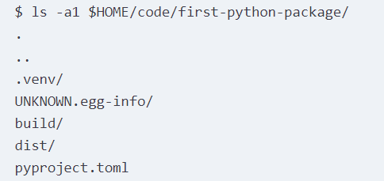
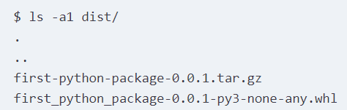

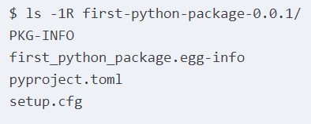
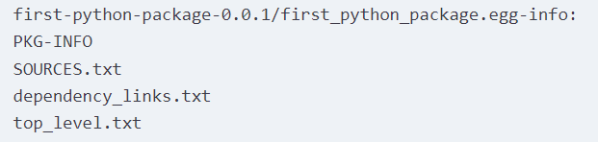
Distribution Package Artifacts Created
Notes:
The contents of the dist/ directory, where you should see the source and binary wheel package files

Slide 11
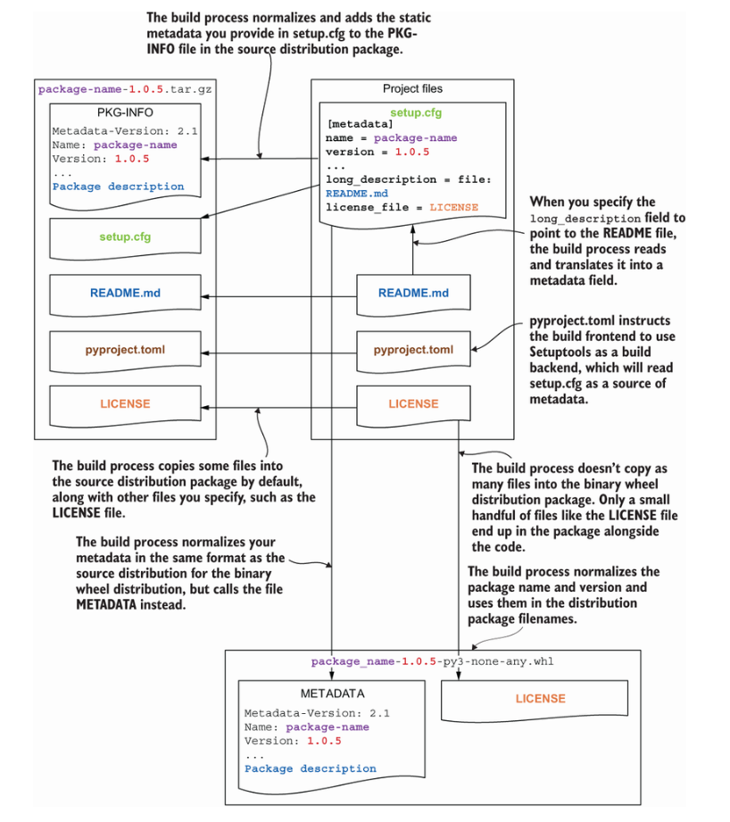
Metadata bet. project and distribution package
Notes:
The flow of metadata between input project files and output distribution package files

Slide 12
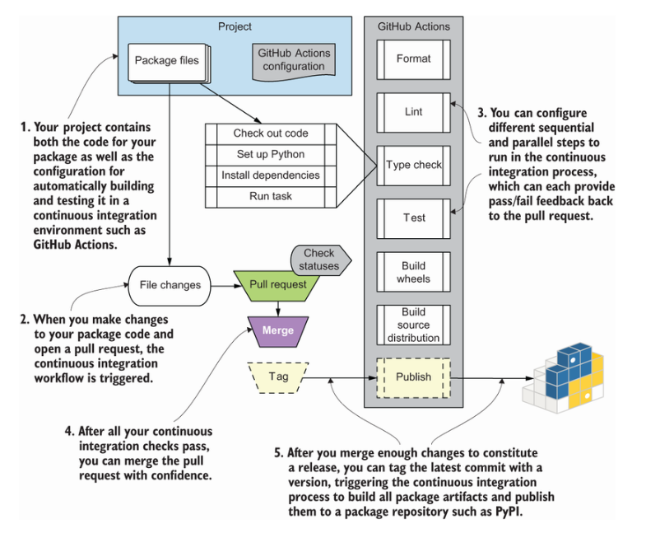
A Continuous Integration Pipeline
Notes:
A continuous integration pipeline flow for Python packaging using GitHub Actions to automate yours tasks of building and publishing your Distribution Package to PyPI.
I’ll be showing you a “slim” version of this pipeline that I have working that’s publishing with OpenID Connect to PyPI Trusted publishing exchange.
Todo (share links):
https://test.pypi.org/project/pubpypack-gadget-wilber-hdez
https://github.com/wilberh/pubpypack-gadget-wilber-hdez
## INSTALLATION
pip install -i https://test.pypi.org/simple/ pubpypack-gadget-wilber-hdez
## IMPLEMENTATION
```shell
>>> from imppkg import hello
>>> hello.first_word
'hello'
>>>

Slide 13
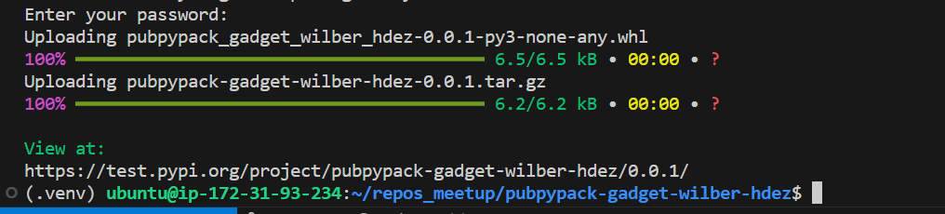
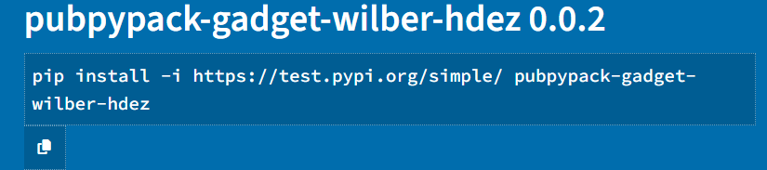
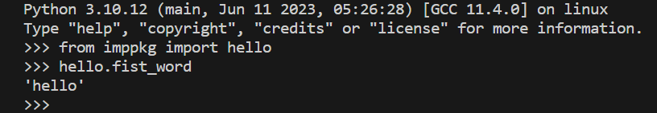
Deployment / Publishing Your Package
Create an PyPI user account
https://pypi.org/account/register/
“Claim” the package name you want to use on PyPI
Check if your package name already exists on PyPI, https://pypi.org
Manually upload your package
You can test on https://test.pypi.org before trying on live home page
Use Twine-tool to publish your package, https://twine.readthedocs.io/en/stable/
Notes:
Imagine you’ve finally finished creating a package, complete with 100% unit test coverage.
Before you can automate publishing your package properly, you first need to “claim” the package name you want to use on PyPI by manually uploading your package. I strongly urge you to use the format pubpypack-harmony-<firstname>-<lastname> for your package if you’re following the exercises in this book closely so that you don’t use up good package names on PyPI for your practice package. Update the name field in your setup.cfg file to use this format now. You should also check whether a package with that name already exists by searching for it from the PyPI home page (https://pypi.org) or visiting what would be the project’s URL (https://pypi.org/project/pubpypack-harmony-<firstname>-<lastname>), in case you share your name with another reader. This will also help me find all your successes more easily! My version lives at https://pypi.org/project/pubpypack-harmony-dane-hillard.
https://test.pypi.org/project/pubpypack-gadget-wilber-hdez
pip install -i https://test.pypi.org/simple/ pubpypack-gadget-wilber-hdez
TIP
You can also do all these same steps on the test PyPI instance (https://test.pypi.org/), which is helpful for trying new things out before doing them on the live instance. You need to create a separate account and any other credentials specific to the test instance if you decide to do so.
After you settle on a package name, you can use the twine (https://twine.readthedocs.io/en/stable/) tool to publish your package. To do so, you need to have your PyPI username and password handy. When you’re ready, run the following commands from the root of your package to create a source distribution and upload it to PyPI. You’ll be prompted to enter your PyPI credentials:
$ pipx install twine
$ pyproject-build --sdist
$ twine upload dist/*
Or
$ twine upload --repository testpypi dist/*
Username: __token__
Password: <paste token>
https://test.pypi.org/project/pubpypack-gadget-wilber-hdez
pip install -i https://test.pypi.org/simple/ pubpypack-gadget-wilber-hdez
TIP
You can create a tox environment for uploading the package using twine. This can be helpful for running repeatedly while debugging issues, and is especially helpful if you use a private package repository such as Artifactory that requires you to specify a nonstandard repository URL.
After you successfully upload the package, it becomes associated with your account. This allows you to create an API token specific to that package, which is very useful for automation purposes because you don’t need to use your personal username and password directly. Create an API token specific to your package now using the following steps:
Visit the API token creation page (https://pypi.org/manage/account/token/).
Give the token a name you’ll recognize, such as pubpypack.
Select Project: pubpypack-something-<firstname>-<lastname> from the Scope dropdown menu.
Click Add Token.
After you add the token, you’ll be shown a page with the contents of the token (see figure 7.14). You should copy this token somewhere for safekeeping, because you’ll be able to access it only this one time. You can always generate a new one later, but if you lose the token, you may need to update it in a variety of places, depending on where you used it.
Now you need to add your newly created PyPI API token as a secret in your GitHub repository.
Secrets are sensitive information that GitHub Actions encrypts for storage.
They can be injected into GitHub Actions but aren’t viewable directly by anyone.
—-----------------
Fyi -
For Github Actions, use the pypa/gh-action-pypi-publish@1.5.0 action from the PyPA to take care of the publishing details. This action uses twine under the hood, but reduces the amount of configuration you need to manage.
- uses: pypa/gh-action-pypi-publish@1.5.0 ❻
with:
user: __token__ ❼
password: ${{ secrets.PYPI_API_TOKEN }}
—-----------------
Fyi -
If we don't want to fire up our browser to go searching through the index, we can also do it from the command line through pip, as shown in the following command:
$ python3 -m pip search asyncio
—-----------------
Fyi -
Installing the package from https://test.pypi.org/<python package>/
$ pip install --index-url https://test.pypi.org/simple/ --no-deps masifutilv2
Or
$ pip install -i https://test.pypi.org/simple/ pubpypack-gadget-wilber-hdez
As we can see in the console output, pip is searching for the module in Test PyPI.
Once it finds the package with the name masifutilv2, it starts downloading and then installing it in the virtual environment.
—-----------------
Fyi -
You can upload packages to the Python Package Index (PyPI) or a private repository, using a tool like Twine.
—-----------------

Slide 14
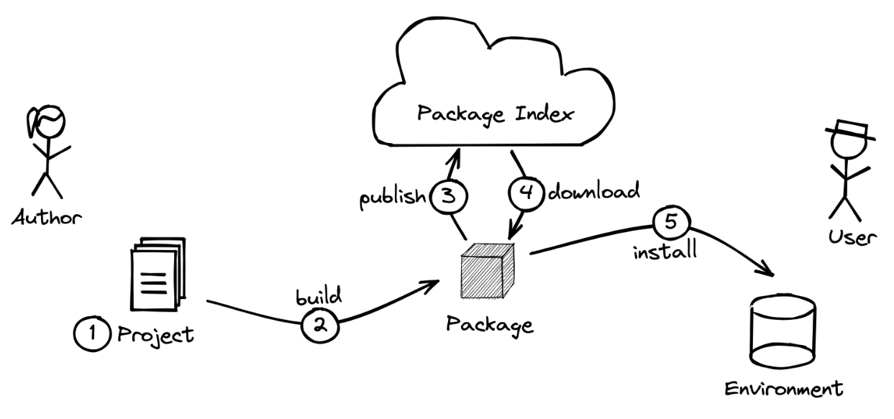
Package Lifecycle
Notes:
So far we’ve covered 1, 2, and 3 of the package lifecycle.
Let’s move on to the rest by talking about PIP.

Slide 15
PIP Package Manager
(Configuring PIP)
Reasons for adding a configuration file:
Company hosting a private package index
Issues with cache so force PIP to redownload
Control where PIP puts downloaded and extracts files
Notes:
Now, lets go over using PIP and configuring it.
PIP is configurable in a variety of ways. Here are some reasons you might want to add a configuration file to your project:
Your company uses a private package index to keep intellectual property private
You don’t trust that the cache is in a good state and you want to force pip to redownload everything
You want to control where pip puts downloaded files and where it extracts them to

Slide 16
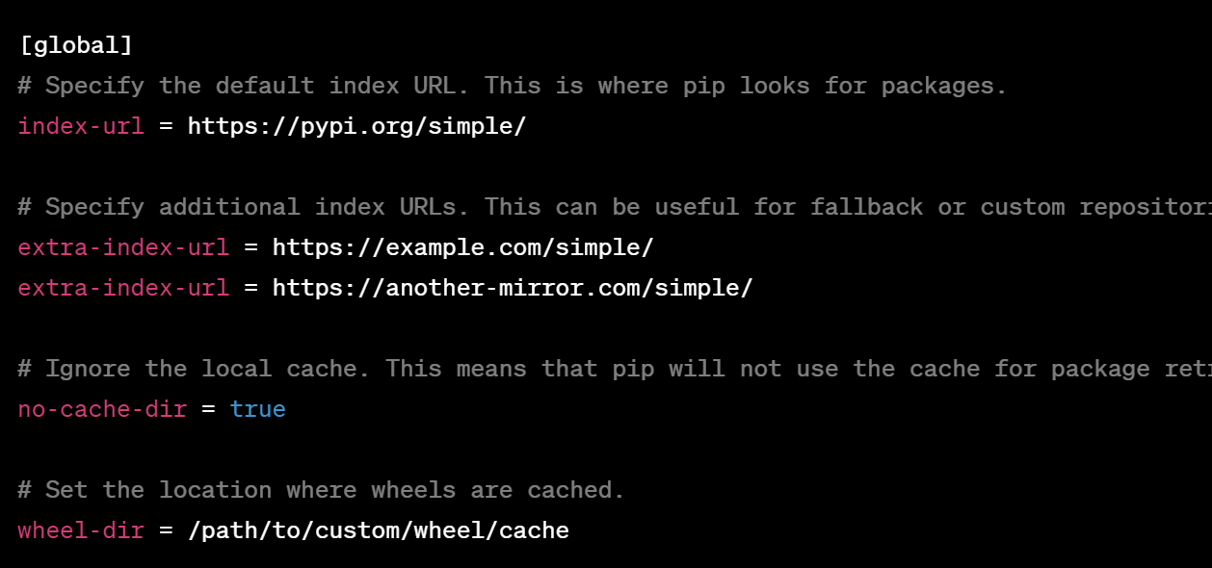
PIP Package Manager
(Configuring PIP continues)
Here’s an example of the configuration file (also available in CLI)
This could be your company’s internal package index
This ignores the local cache
This puts wheels in a custom location
Notes:
PIP configuration solves all of those problems listed.
Here’s an example:
All of these configuration options are available on the command line too!

Slide 17
PIP Package Manager
(Configuring PIP continues)
Why install packages from a local directory?
You’re developing a package/library and want to make sure it works
python -m pip install path/to/SomeProject
Keep in mind that you can also install an *editable* version of your package. This lets you develop and test your library without reimporting and reinstalling!
python -m pip install -e path/to/SomeProject
Notes:
Let's continue with Installing packages from a local directory.
Why would you want to do this?
You’re developing a package and you want to check that the library works in a particular situation
You’ve built a library but haven’t released it to the package index yet
As for editable installs -
when creating a Python project, developers usually want to implement and test changes iteratively, before cutting a release and preparing a distribution archive.
To facilitate iterative exploration and experimentation, setuptools allows users to instruct the Python interpreter and its import machinery to load the code under development directly from the project folder without having to copy the files to a different location in the disk.
This means that changes in the Python source code can immediately take place without requiring a new installation.
You can enter this “development mode” by performing an editable installation inside of a virtual environment, using pip’s -e/--editable flag
# Activate your environment with:
$ pip install --editable .
# Now you have access to your package
# as if it was installed in .venv
$ python -c "import your_python_project"
https://setuptools.pypa.io/en/latest/userguide/development_mode.html#development-mode-a-k-a-editable-installs

Slide 18
PIP Package Manager
(When PIP isn’t enough)
The pipenv package is meant to streamline your workflow
Instead of:
python -m venv venv
source venv/bin/activate
pip install requests
Manually managing dependencies
You could do:
pipenv install requests
and pipenv will take care of the rest
Notes:
Juggling pip, python, and virtual environments can be a lot.
You can use the pipenv package that’s meant to streamline your workflow.
Pipenv is a tool that provides all necessary means to create a virtual environment for your Python project. It automatically manages project packages through the Pipfile file as you install or uninstall packages. Pipenv also generates the Pipfile.

Slide 19
Q&A
What is the difference between a module and a package?
What are absolute and relative imports in Python?
What is PyPA?
What is Test PyPI and why do we need it?
Is an init file a requirement to build a package?
Notes:
Package initialization file
A package can have an optional source file named __init__.py (or simply an init file). The presence of the init file (even a blank one) is recommended to mark folders as packages. Since Python release 3.3 or later, the use of an init file is optional (PEP 420: Implicit Namespace Packages). There can be multiple purposes of using this init file and there is always a debate about what can go inside an init file versus what cannot go in. A few uses of the init file are discussed here:
Empty __init__.py:
This will force developers to use explicit imports and manage the namespaces as they like. As expected, developers have to import separate modules, which can be tedious for a large package.
Full import in __init__.py:
In this case, developers can import the package and then refer to the modules directly in their code using the package name or its alias name. This provides more convenience but at the expense of maintaining the list of all imports in the __init__ file.
Limited import:
This is another approach in which the module developers can import only key functions in the init file from different modules and manage them under the package namespace. This provides the additional benefit of providing a wrapper around the underlying module's functionality. If by any chance we have to refactor the underlying modules, we have an option to keep the namespace the same, especially for API consumers. The only drawback of this approach is that it requires extra effort to manage and maintain such init files.
Sometimes, developers add code to the init file that is executed when a module is imported from a package. An example of such code is to create a session for remote systems such as a database or remote SSH server.

Slide 20
Q&A
What is the difference between a module and a package?
A module is meant to organize functions, variables, and classes into separate Python code files. A Python package is like a folder to organize multiple modules or sub-packages.
What are absolute and relative imports in Python?
Absolute import requires the use of the absolute path of a package starting from the top level, whereas relative import is based on the relative path of the package as per the current location of the program in which the import statement is to be used.
What is PyPA?
The Python Packaging Authority (PyPA) is a working group that maintains a core set of software projects used in Python packaging.
What is Test PyPI and why do we need it?
Test PyPI is a repository of software for the Python programming language for testing purposes.
Is an init file a requirement to build a package?
The init file is optional since Python version 3.3.
Notes:
Package initialization file
A package can have an optional source file named __init__.py (or simply an init file). The presence of the init file (even a blank one) is recommended to mark folders as packages. Since Python release 3.3 or later, the use of an init file is optional (PEP 420: Implicit Namespace Packages). There can be multiple purposes of using this init file and there is always a debate about what can go inside an init file versus what cannot go in. A few uses of the init file are discussed here:
Empty __init__.py:
This will force developers to use explicit imports and manage the namespaces as they like. As expected, developers have to import separate modules, which can be tedious for a large package.
Full import in __init__.py:
In this case, developers can import the package and then refer to the modules directly in their code using the package name or its alias name. This provides more convenience but at the expense of maintaining the list of all imports in the __init__ file.
Limited import:
This is another approach in which the module developers can import only key functions in the init file from different modules and manage them under the package namespace. This provides the additional benefit of providing a wrapper around the underlying module's functionality. If by any chance we have to refactor the underlying modules, we have an option to keep the namespace the same, especially for API consumers. The only drawback of this approach is that it requires extra effort to manage and maintain such init files.
Sometimes, developers add code to the init file that is executed when a module is imported from a package. An example of such code is to create a session for remote systems such as a database or remote SSH server.
—--------------------------------------------
Fyi-
See __init__.py file for scikit-learn:
https://github.com/scikit-learn/scikit-learn/blob/main/sklearn/__init__.py

Slide 21
Resources
Books
Publishing Python Packages, by Dane Hillard (February 2023)
Hypermodern Python Tooling, by Claudio Jolowicz (April 2024)
Emily Charles (Boston Meetup group)
Webpage - “Package management: a brief history”, https://blog.tidelift.com/a-brief-history-of-package-management, by by Jeremy Katz (December 19, 2017)
Sample pyproject.toml metadata file, https://packaging.python.org/en/latest/tutorials/packaging-projects/#configuring-metadata
Writing Your pyproject.toml file, https://packaging.python.org/en/latest/guides/writing-pyproject-toml/#writing-your-pyproject-toml
Adding a trusted publisher to an existing PyPI project, https://docs.pypi.org/trusted-publishers/adding-a-publisher/
Notes:
Publishing Python Packages, by Dane Hillard (February 2023)
Ebook (paywall): https://learning.oreilly.com/library/view/publishing-python-packages/9781617299919/
Book repo: https://github.com/daneah/publishing-python-packages/tree/main
Hypermodern Python Tooling, by Claudio Jolowicz (April 2024)
Ebook (paywall): https://learning.oreilly.com/library/view/hypermodern-python-tooling/9781098139575/
Book repo: since this an early release ebook, the github repo will be made active later on

